Slide 1
Colonial Regions
http://www.youtube.com/watch?v=YOwvc_NdWtk

Slide 2
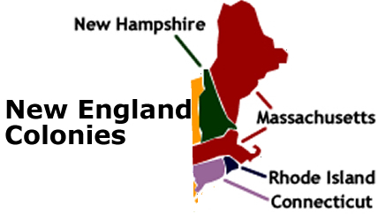
Geography:
Long, cold winters
Short, cool summers
Poor, rocky soil
Hills and mountains
Economic:
Whaling/fishing, ship building
Shipping/Trade
Timber
Subsistence farming (only enough to eat)
Religion
Mostly Puritans
Many other denominations increase (branches of Christianity)

Slide 3
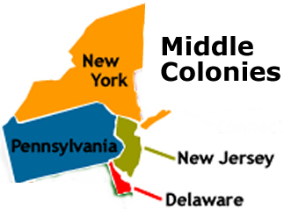
Geography:
Temperate (not too hot, not too cold)
Rich soil
Varied terrain
Economic:
Farming → “bread basket”
Livestock, Lumber
Shipping and trade
Towns and farms
Religion
Quakers, Protestant, Various others

Slide 4
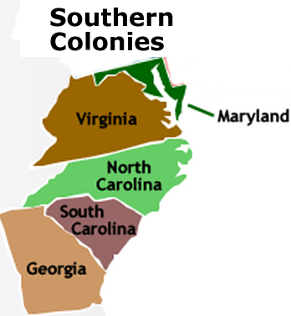
Geography:
Long, hot summers
Short, mild winters
Fertile soil
Economic:
Farming/Cash crops
Plantations (farms too big for one family to manage)
Slave labor
Lumber,fishing
Religion
Church of England (Anglican)
Catholics (MD)
various others

